Slide 1

Dr House
MY FAVOURITE TV SHOW CHARACTOR

Slide 2

“It's a basic truth of the human condition that everybody lies. The only variable is about what.”

Slide 3
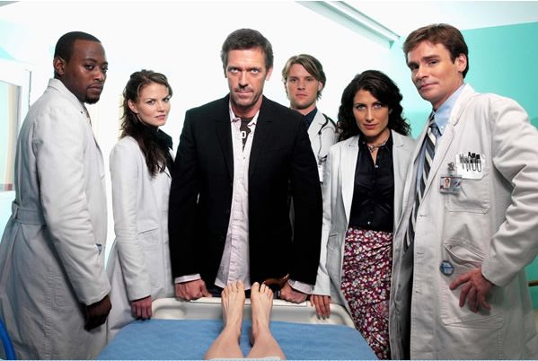
Diagnostics Team Of House MD

Slide 4
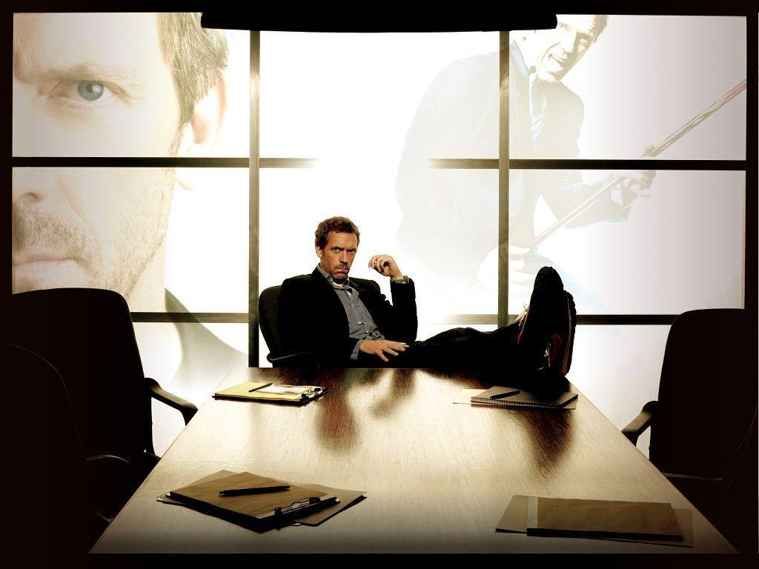
Dr. House The Genius Doctor

Slide 5
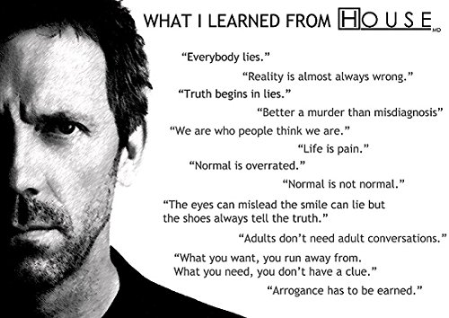

Slide 6

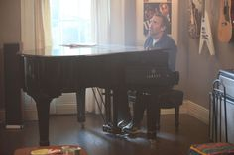
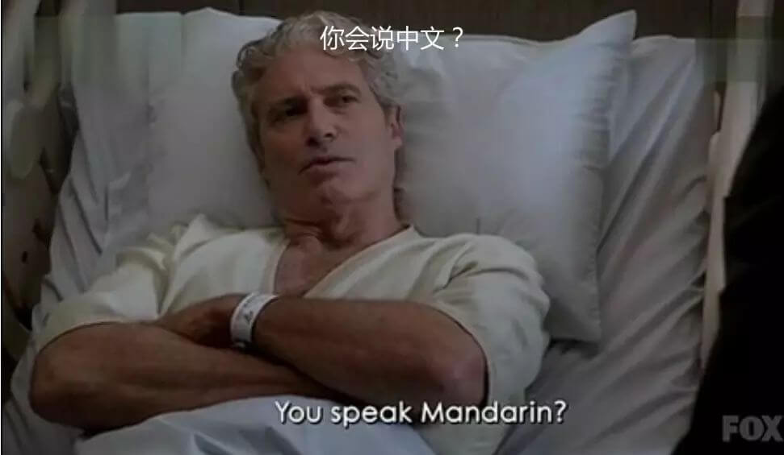
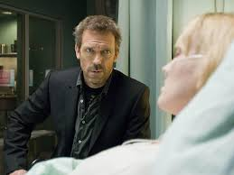
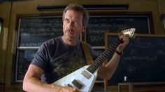
BEING AN EXTRODINARY DOCTOR

Slide 7
WHAT WE CAN LEARN FROM HIM?

Slide 8
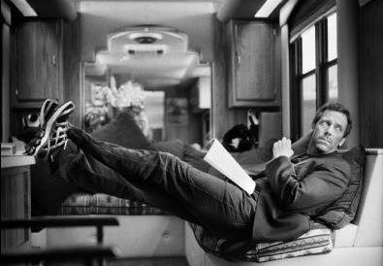
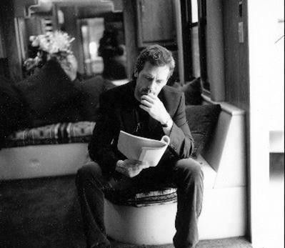
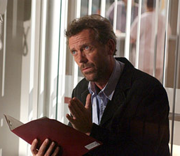
KNOWLEDGE BASE
Improving your knowledge will strengthen your conclusions.

Slide 9
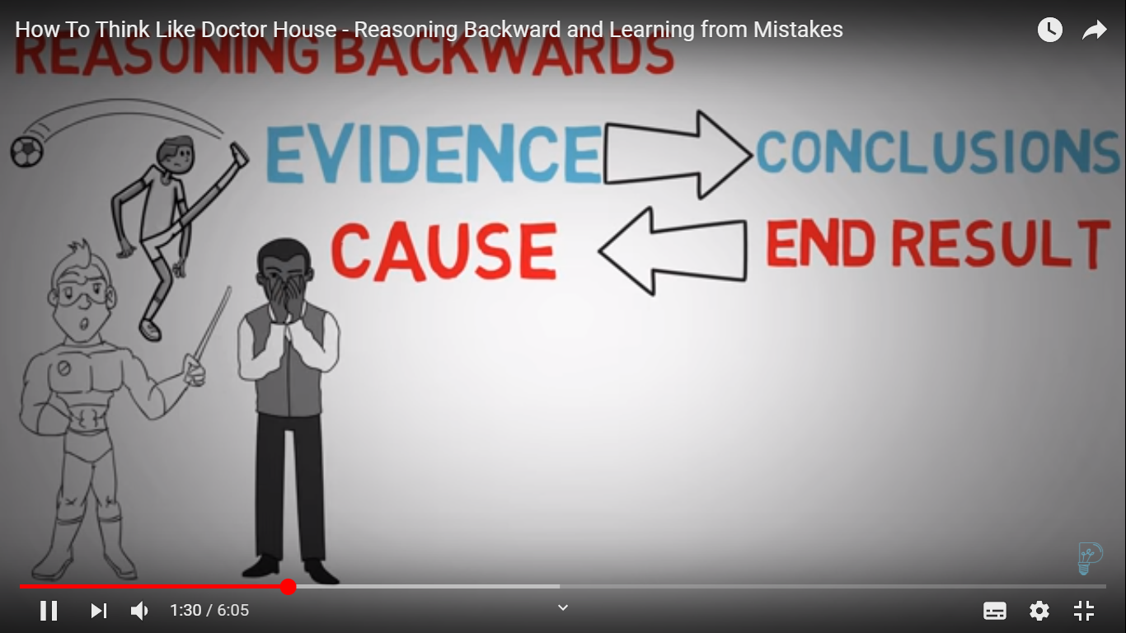
2. REASONING BACKWARDS

Slide 10
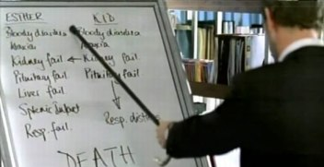
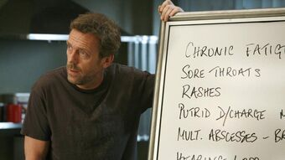
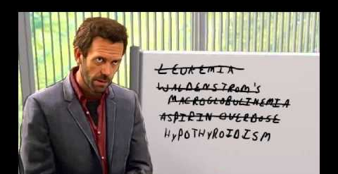
3.KEEPING AN OPEN MIND
“YOU MAY BE WRONG”
Don’t eliminate possible conclusions.
Don’t jump to conclusions

Slide 11
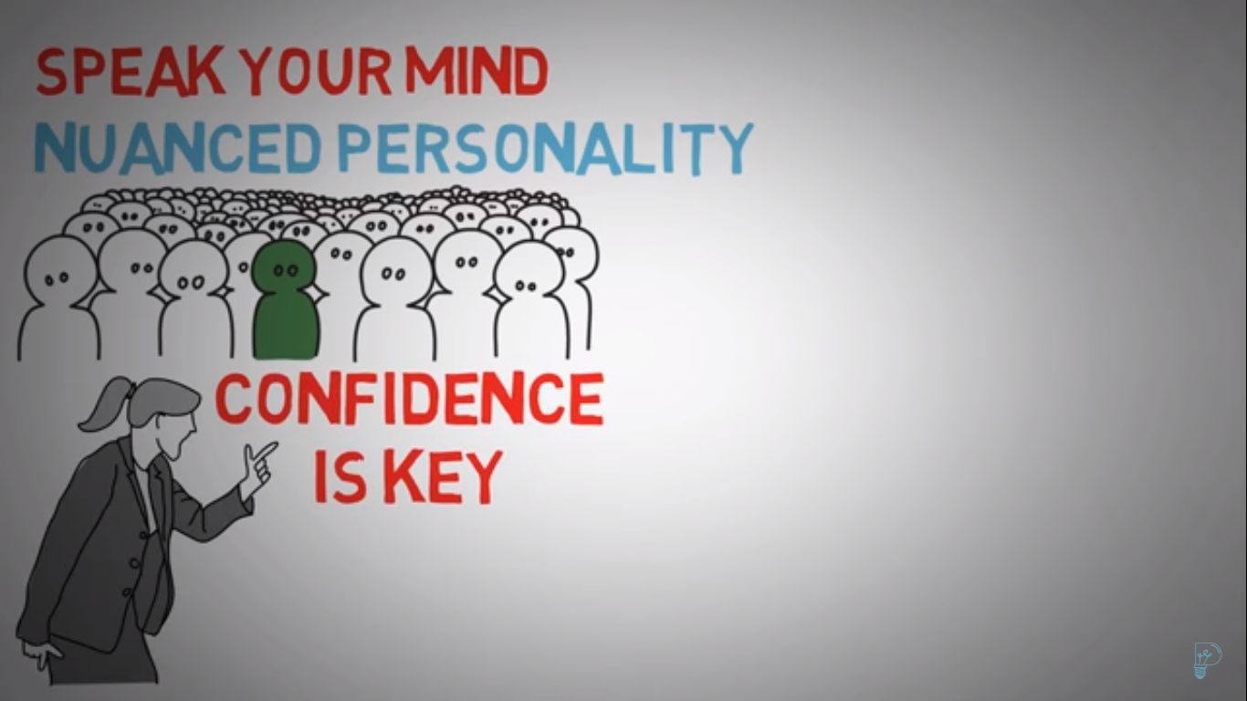
4. SPEAK YOUR MIND

Slide 12
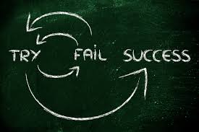
5. LEARN FROM YOUR MISTAKES
Only improve from trail and error. It takes lot of experience.
Don’t ignore your mistakes.
Find out Why?
Write down the reasons.
Learn to improve.
Mistakes are chance to learn.

Slide 13
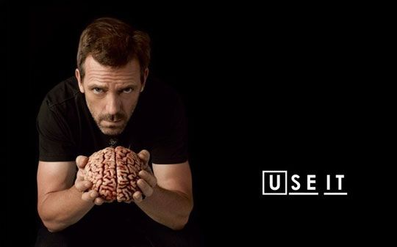
Thank you!

